Slide 1

Batch Normalization
Normalizing activations
in a network
deeplearning.ai

Slide 2



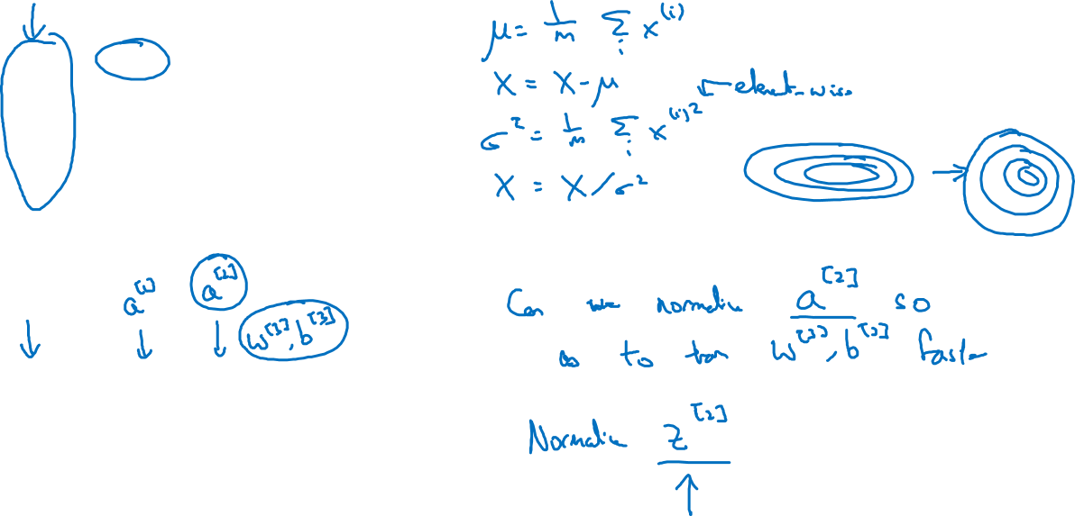






Normalizing inputs to speed up learning
$$x_{1}$$
$$w,b$$
$$x_{2}$$
$$\hat{y}$$
$$x_{3}$$
$$x_{1}$$
实践中，多数是对z做normalize而不是a
$$x_{2}$$
$$\hat{y}$$
$$x_{3}$$

Slide 3
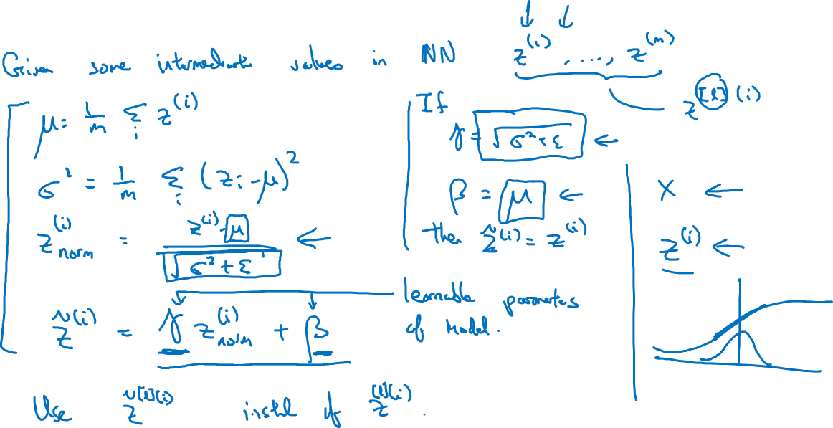
Implementing Batch Norm

